Slide 1
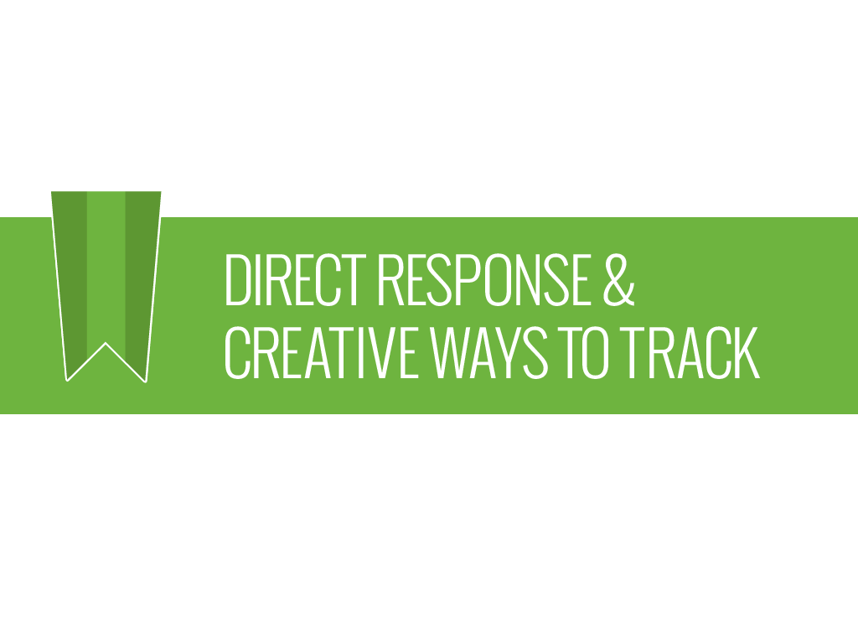
October 29, 2013
© 2013 Shepherd. All rights reserved. Any duplication, reproduction or usage of this document or any portion thereof without the written consent from Shepherd is prohibited.

Slide 2
What is Direct Response?
Best Practices
Form of marketing that requires a “trackable” action by the target audience.
Easy to measure the effectiveness of print ads, emails, postcard, flyers, banner ads and other marketing vehicles.

Slide 3
Direct Response Best Practices

Slide 4
Start with a Plan
Set clear measurable objectives
Determine key target audiences
Develop quarterly action plans and budgets
Continuous evaluation of bottom-line results

Slide 5
Maximizing success depends…
first on your list
second on the offer,
third on the copy and graphics
Source: http://www.directcreative.com/blog/30-timeless-direct-marketing-principles

Slide 6
Key Elements for Success
Strong relevant offer and copy
Call to action (mail, phone, fax, mobile or online)
Deadline to create urgency
Measuring response through to “conversion” (sales)
Testing to improve response, results

Slide 7
Factors to consider for the offer
Price
Incentives (Free gift, Refer a friend, Coupon, etc.)
Time limits
Quantity limits
Credit options
Future obligation
Source: “Successful Direct Marketing Methods” Bob Stone & Ron Jacobs, 2001

Slide 8
Test the big things to improve response
Offer or promotion
Format – mail postcard, email, etc.
Frequency/timing
Copy
Source: “Successful Direct Marketing Methods” Bob Stone & Ron Jacobs, 2001

Slide 9
Other Principles
2nd sale is most important. A 2x buyer is twice as likely to buy again as a 1x buyer.
Renting a List?: If “Hotline” (3 mo) names don’t work, other list segments will offer little success.
A follow-up to same list within 30 days will pull 40%- 50% of first mailing.

Slide 10
Offers with a specific deadline date outpull offers with no time limit practically every time.
Free gift offers, particularly when the gift appeals to self-interest, outpull discount offers consistently.
The longer you can keep someone reading your copy, the better your chances of success.

Slide 11
Develop your own mailing and email lists. They are the most valuable.
Grow out-of-area leads by capturing and adding them to your list
Organize your list to better identify segments within lt.
Subscribers, single tickets buyers, donors, out-of-market visitors, etc.

Slide 12
Sort your mailing list by segments to better market to them.
Tailor communications by audience.
Sort by zip codes to identify out of market patrons.
Track response rates for each segment by offer.

Slide 13
Create a direct response history
to predict/project the future.
Establish response rate for each segment.
Establish response rate relationships between segments.

Slide 14
Direct Response Projections Is it worth doing a mailing?
Mailing
Event: Limelight Theatre Event
 |  | Quantity Mailed/ emailed |  | Inquiries % |  | Inquiries No. |  | Sales % |  | Sales No. | Average Transaction |  | Revenue
List:
Subscribers |  | 20,000 |  | 10% |  | 2,000 |  | 25% |  | 500 | $20 |  | $10,000
Single Tix |  | 20,000 |  | 5% |  | 1,000 |  | 10% |  | 100 | $20 |  | $2,000
Out of Mkt |  | 20,000 |  | 1% |  | 200 |  | 5% |  | 10 | $20 |  | $200
Total |  | 60,000 |  |  |  |  |  |  |  |  |  |  | $12,200

Slide 15
Direct Response Measurement
Creative Ways To Track

Slide 16
Identify and understand your audience
Visual observation: Age, gender, affluence, singles, couples, families, etc.
What to benchmark and track
Attendance by event
First time visits, repeat visits, lapsed visitors
Out of the county visits

Slide 17
Analyze past purchases:
Use your own lists, database
Analyze behavior by segment:
Single-ticket buyer, subscribers, donors, out-of-market visitors, etc.
Analyze what zip codes they are coming
from to better decide where to market
Analyze by event

Slide 18
Analyze current sales:
Code every out-of-market promotional flyer, direct mail piece, coupon, ad, etc.
Require the patron to
Bring the coupon in to redeem it
Give you the code over the phone, or via email
Enter the code when they order online
Track/Count the results

Slide 19
ASK. Create short survey.
Capture patron information at events
Create a short online survey and email a link to it.
Fill out the short paper survey at the event
Offer Incentive: entry into a drawing of several door prizes that will be announced at the event

Slide 20
Ask questions below. Capture their answers:
How did you hear about us?
Where did you go for information about us?
1.) Internet 2.) phone 3.) other __________
What city/state/zip are you from?
Are you staying overnight here? Where are you staying?
1.) Hotel/motel 2.) B&B 3.) rental 4.) With friends and family 5.) other _____________

Slide 21
The value of anecdotal or organic discovery during in-person visit or online to capture information, is
Tracking out-of-market visitors
Gaining insights about your customers.

Slide 22
Any questions about Direct Response?

