Slide 1

Florida’s Historic Coast Cultural Destination
Brand Marketing Workshop
For St. Johns County Arts, Cultural and Heritage Organizations
Oct. 29, 2013

Slide 2
      Workshop Agenda
          Branding
          Public Relations
          Media Planning
          Direct Response & Creative Ways to Track
          Social Media
          Web Analytics

Slide 3

October 29, 2013
© 2013 Shepherd. All rights reserved. Any duplication, reproduction or usage of this document or any portion thereof without the written consent from Shepherd is prohibited.

Slide 4

Brand Objectives
Increase overnight stays
Generate awareness as unique cultural destination
Create a pipeline: Interest – visit – return
Measure/track results
Target Audience Focus:
Affluent women and families
Past and new overnight visitors

Slide 5
Cultural Destination Brand
CREATIVE RECOMMENDATIONS

Slide 6
THE BRAND IDEA
Come experience the many sides of Florida’s Historic Coast.

Slide 7
The Pennants
Marks the Historic Coast as a cultural destination
Series of pennants symbolizes the diversity
of cultural offerings
Pennants appear in templates, print pieces,
online ads
Use physical flags to identify cultural places
and events

Slide 10
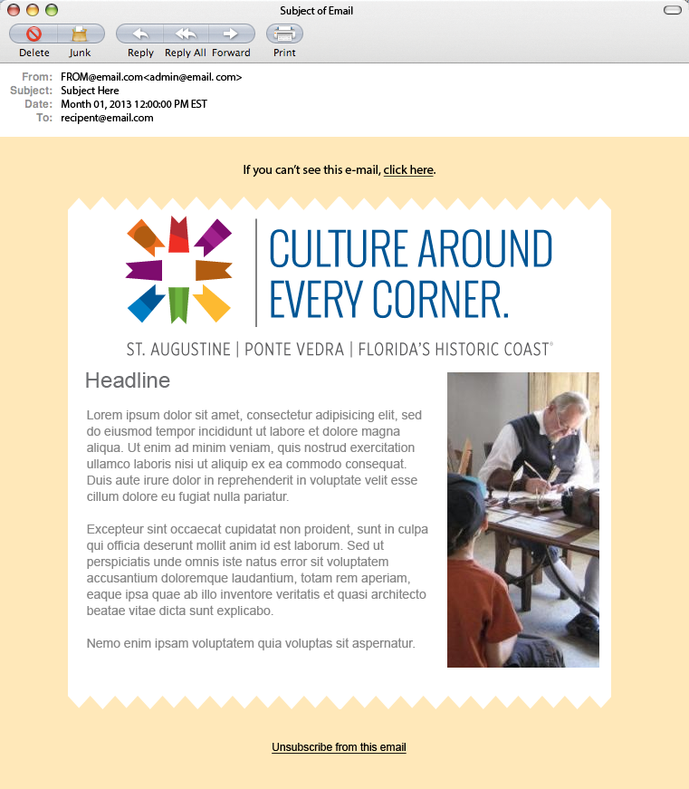


Slide 11
Logo Guide
The multi-colored pennant square logo is the primary logo, and may be used in a horizontal or vertical orientation. Always use the color logo when full color application is available. Alternate color versions have been created for occasions when a black, white or type option is needed.
The pennant square logo may be used with or without the tagline “Culture Around Every Corner.”
A version with the tagline lock-up and without the tagline lock-up have been provided.
Never replace the tagline type with another typeface or color. Do not alter the placement of the tagline to the logo. Never redraw or alter the logo, including the placement and size relationship of the pennant square to the type.
For authorized, original artwork for the Historic Coast Culture logo,
please contact the St. Johns Cultural Council.

Slide 12
Horizontal Primary Logo

Slide 13
Horizontal Primary Logo

Slide 14
Vertical Primary Logo

Slide 15
Vertical Primary Logo

Slide 16
Colors | Pantone & 4C Process

Slide 17
Typefaces

Slide 18

A system of individual logos has been developed to identify the different categories of cultural
offerings on Florida’s Historic Coast. These pennants correspond to the following categories:
^{Visual Arts} ^{Performing Arts} ^{Literary Arts}
^{Festivals Living History} ^{Many Cultures}
Alternate Logos - Color

Slide 19
Alternate Logos – Black & White

Slide 20
Alternate Logos – Reversed

Slide 21
Ad Templates

Slide 22
Postcard Template

Slide 23
Any questions
about Branding?

Slide 24

October 29, 2013
© 2013 Shepherd. All rights reserved. Any duplication, reproduction or usage of this document or any portion thereof without the written consent from Shepherd is prohibited.

Slide 25

What is media relations?
Media relations is building relationships with
contacts at media outlets, informing the public
about your company or organization.

Slide 26
What are the tools of media relations?
Communications plan
Media list
Editorial calendar
Fact sheet
Media kit
Press releases
Pitches

Slide 27
Creating a Media List
“To truly do your job, you need to be immersed in
the industry news and know whom you’re targeting.”
Identify the story
Sharpen your focus
Create your outlet list
Fill in the gaps
Find your reporter
Use social media
Call
Monitor
Source: Ragan’s PR Daily - http://www.prdaily.com/Main/Articles/How_to_build_a_robust_media_listfor_free_12053.aspx

Slide 28
Press Releases – The Basics
Five Tips: On Writing A Press Release
Be sure to cover the basics in the first paragraph:
who, what, where, when, why and how.
Make sure you include a date and contact information
for follow up.
Use the third-person tense (for example, he, she, and
they, rather that I or we).
Stick to the facts and, if you want to share an opinion,
put it in quotes and attribute the statement.
Proofread the release carefully!

Slide 29
What makes a story relevant?
Timeliness
Remember target audience
Significance
Prominence/Names
Unusualness/oddity
Human Interest

Slide 30
Helpful Advice
Free lead services
Maximize partnerships
Participate in the conversation
Be a journalist

Slide 31
Measuring Media Relations Results
Google alerts
Search
Measure: number of placements,
impressions

Slide 32
PR Media Relations Toolkit
Press release template
Historic Coast visitor profile
Communicating to the media
Making your story attractive

Slide 33
Any questions about
Media Relations?

Slide 34

October 29, 2013
© 2013 Shepherd. All rights reserved. Any duplication, reproduction or usage of this document or any portion thereof without the written consent from Shepherd is prohibited.

Slide 35

What is media planning?
Getting the right message…
...in front of the right person…
…at the right time…
…with the right amount of money…
…to generate the right response.

Slide 36
Planning Process
Marketing Input
Media Objectives
Media Strategies
Business model, marketing strategy, research, industry trends
Business / sales objectives & strategies for upcoming year, new product launches, major initiatives to focus on, etc.
Translate business objectives into media goals
Translate media goals into strategic media planning guidelines

Slide 37
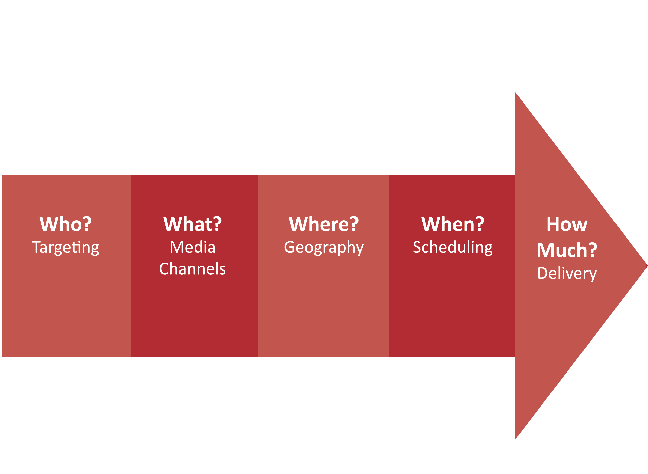
Media Plan Components

Slide 38
Target Analysis
To determine the right target audience
To understand audience behaviors and
media consumption habits
Ensures efficiency, avoids waste,
prevents overexposure

Slide 39
Media Math
Reach
- Size of audience
- Number of actual audience members exposed to your
message at least once during advertising period (ex: 60%
of A 18-25)
Frequency
Number of times each audience member sees/hears your message during advertising period (ex: 3x)
Gross Impressions
Reach x Frequency
Number of people reached (x) number of times they saw an ad across media vehicles

Slide 40
Media Channel Analysis
Criteria | TV | RAD | NPR | MAG | OOH | .COM
Mass coverage / High Reach
High Frequency / Sales Driver |  |  | FSIs, coupons |  | POP | Email
Favorable Image / Creative Potential
Information Sharing
Cost Efficient
Message Shelf-Life
Measurability

Slide 41
Media Consumption: Quintiles
Amount of time target spends using
different media guides media selection
Usage measured at 5 levels:
Heavy, Heavy-Medium, Medium,
Medium-Light, Light

Slide 42
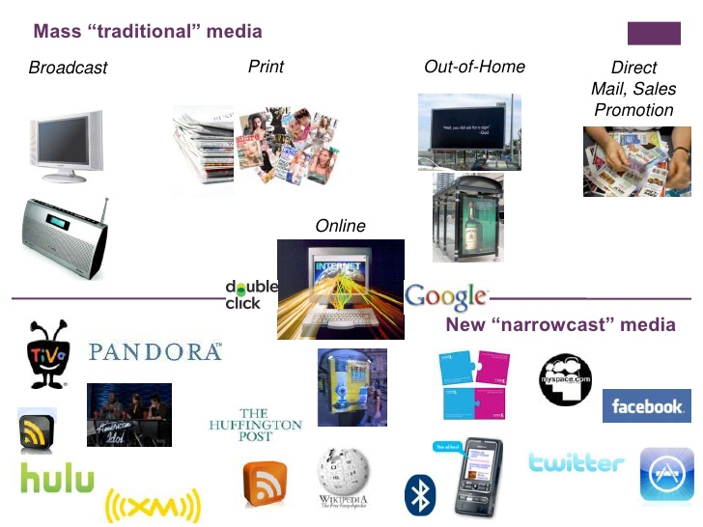
Mass Traditional Media

Slide 43
Questions for Market Selection
Where do the majority of your sales come from?
Is there natural need for your product in certain regions?
What is the opportunity for growth? Are there
markets where the category has potential but it
remains underdeveloped?
Where is the competition strong? Do we want to compete?
What is your budget?
Answer = National, Regional, Local, or Zip Code

Slide 44
Scheduling Analysis
Related to consumer decision-making times
When should we promote our product to maximize purchase?
- Time of year (seasonally)
- Time of month (purchase windows, sales, and promotions)
- Time of day (day parts)
Strategies
- Continuity
- Flighting
- Pulsing

Slide 45
Any questions about
Media Planning?

Slide 46
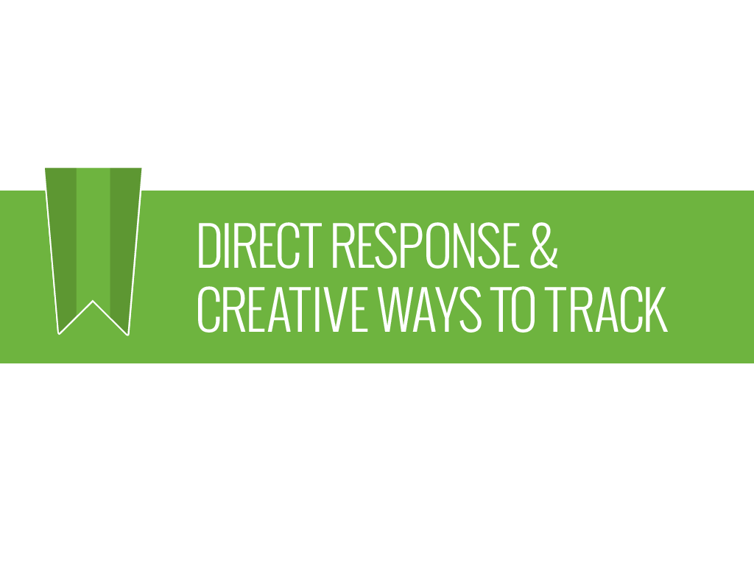
October 29, 2013
© 2013 Shepherd. All rights reserved. Any duplication, reproduction or usage of this document or any portion thereof without the written consent from Shepherd is prohibited.

Slide 47

What is Direct Response?
Best Practices
Form of marketing that requires a “trackable”
action by the target audience.
Easy to measure the effectiveness
of print ads, emails, postcard, flyers, banner ads
and other marketing vehicles.

Slide 48
Direct Response Best Practices

Slide 49
Start with a Plan
Set clear measurable objectives
Determine key target audiences
Develop quarterly action plans and budgets
Continuous evaluation of bottom-line results

Slide 50
Maximizing success depends…
first on your list
second on the offer,
third on the copy and graphics
Source: http://www.directcreative.com/blog/30-timeless-direct-marketing-principles

Slide 51
Key Elements for Success
Strong relevant offer and copy
Call to action (mail, phone, fax, mobile or online)
Deadline to create urgency
Measuring response through to “conversion” (sales)
Testing to improve response, results

Slide 52
Factors to consider for the offer
Price
Incentives (Free gift, Refer a friend, Coupon, etc.)
Time limits
Quantity limits
Credit options
Future obligation
Source: “Successful Direct Marketing Methods” Bob Stone & Ron Jacobs, 2001

Slide 53
Test the big things to improve response
Offer or promotion
Format – mail postcard, email, etc.
Frequency/timing
Copy
Source: “Successful Direct Marketing Methods” Bob Stone & Ron Jacobs, 2001

Slide 54
Other Principles
2nd sale is most important. A 2x buyer is twice as likely to buy again as a 1x buyer.
Renting a List?: If “Hotline” (3 mo) names don’t work, other list segments will offer little success.
A follow-up to same list within 30 days will pull 40%- 50% of first mailing.

Slide 55
Offers with a specific deadline date outpull offers with no time limit practically every time.
Free gift offers, particularly when the gift appeals to self-interest, outpull discount offers consistently.
The longer you can keep someone reading your copy, the better your chances of success.

Slide 56
  Develop your own mailing and email lists.
  They are the most valuable.
  Grow out-of-area leads by capturing
  and adding them to your list
  Organize your list to better identify segments within lt.
  Subscribers, single tickets buyers, donors, out-of-market visitors, etc.

Slide 57
  Sort your mailing list by segments
  to better market to them.
  Tailor communications by audience.
  Sort by zip codes to identify out of market patrons.
  Track response rates for each segment by offer.

Slide 58
  Create a direct response history
  to predict/project the future.
  Establish response rate for each segment.
  Establish response rate relationships between segments.

Slide 59
Direct Response Projections
Is it worth doing a mailing?
Mailing
Event: Limelight Theatre Event
 |  | Quantity Mailed/ emailed |  | Inquiries % |  | Inquiries No. |  | Sales % |  | Sales No. | Average Transaction |  | Revenue
List:
Subscribers |  | 20,000 |  | 10% |  | 2,000 |  | 25% |  | 500 | $20 |  | $10,000
Single Tix |  | 20,000 |  | 5% |  | 1,000 |  | 10% |  | 100 | $20 |  | $2,000
Out of Mkt |  | 20,000 |  | 1% |  | 200 |  | 5% |  | 10 | $20 |  | $200
Total |  | 60,000 |  |  |  |  |  |  |  |  |  |  | $12,200

Slide 60
Direct Response Measurement
Creative Ways To Track

Slide 61
Identify and understand your audience
Visual observation: Age, gender, affluence, singles,
couples, families, etc.
What to benchmark and track
  Attendance by event
  First time visits, repeat visits, lapsed visitors
  Out of the county visits

Slide 62
Analyze past purchases:
  Use your own lists, database
  Analyze behavior by segment:
    Single-ticket buyer, subscribers, donors,
    out-of-market visitors, etc.
  Analyze what zip codes they are coming
  from to better decide where to market
    Analyze by event

Slide 63
Analyze current sales:
  Code every out-of-market promotional flyer,
  direct mail piece, coupon, ad, etc.
  Require the patron to
    Bring the coupon in to redeem it
    Give you the code over the phone, or via email
    Enter the code when they order online
  Track/Count the results

Slide 64
ASK. Create short survey.
Capture patron information at events
  Create a short online survey and email a link to it.
  Fill out the short paper survey at the event
  Offer Incentive: entry into a drawing of several door prizes that will be announced at the event

Slide 65
Ask questions below. Capture their answers:
    How did you hear about us?
    Where did you go for information about us?
      1.) Internet 2.) phone 3.) other __________
    What city/state/zip are you from?
    Are you staying overnight here? Where are
    you staying?
      1.) Hotel/motel 2.) B&B 3.) rental 4.) With friends
      and family 5.) other _____________

Slide 66
The value of anecdotal or organic discovery during
in-person visit or online to capture information, is
  Tracking out-of-market visitors
  Gaining insights about your customers.

Slide 67
Any questions about
Direct Response?

Slide 68

October 29, 2013
© 2013 Shepherd. All rights reserved. Any duplication, reproduction or usage of this document or any portion thereof without the written consent from Shepherd is prohibited.

Slide 69


What is Social Media?
Stimulating Conversation
Simply put:
“Word-of-mouth”
Building relationships

Slide 70
Who uses Social Media?
72%
of online adults use social networking sites
Source: Brenner, Joanna. "Pew Research Center's Internet & American Life Project." Pew Internet: Social Networking (full Detail). N.p., 5 Aug. 2013. Web. 08 Oct. 2013.

Slide 71
72%
< $30K/yr
$30K - $49.9K
of online adults use social networking sites
$50K - $74.9K
$75K +
Source: Brenner, Joanna. "Pew Research Center's Internet & American Life Project." Pew Internet: Social Networking (full Detail). N.p., 5 Aug. 2013. Web. 08 Oct. 2013.

Slide 72





67%
72%
20%
18%
15%
of online adults use social networking sites
13%
Source: Brenner, Joanna. "Pew Research Center's Internet & American Life Project." Pew Internet: Social Networking (full Detail). N.p., 5 Aug. 2013. Web. 08 Oct. 2013.

Slide 73
Develop a Plan
Start small
Get experience
Measure results
Build on what works

Slide 74
Social Content Examples
Engage
Incent
ANNOUNCE community events
SHARE industry news or news
CREATE games/trivia/promotions to only those who follow on Twitter or Facebook
OFFER incentives
Announce
Share

Slide 75

Facebook Basics
URL/26 likes
Convey sense of community
Use pages, not groups
Use “Wall” for discussions/announcements
Use “Notes” as a form of
a blog
Use “Photos” to show your attraction, events, etc.
Facebook ads are an affordable way to boost traffic to your page

Slide 76
Create an Editorial Calendar
DAY | TOPIC | VIDEO/IMG | LINKS | SITES POSTED TO | POST
Mon | Event | Share Graphic | Site.com | Pinterest, Facebook | Wine. Food. Fun. And more wine! St. Augustine’s Spanish Wine Festival starts a week from today. Check the site for times and tickets – all proceeds go to local charities.
Tue | Request for pictures | None |  | Instagram, Facebook | If you have pictures or video from a cultural event in St. Augustine or Ponte Vedra, we’d love to see it! Upload it here, or tag us in the photos you post to your own page.
Wed | Event Reminder | None | Site.com | Facebook | Don’t miss the St. Augustine’s Spanish Wine Festival. Two days left to get your tickets.
Thu
Fri | Opening Night | None | None | Twitter | Wish you were here. Check out pictures from tonight’s event opening.
Sat | Post Event | Images from event | Site.com | LinkedIn, Twitter, Facebook, Pinterest | What a great event. Visit our site for pictures of all the activities. Thanks to all that came out for a fun night.
Sun

Slide 77
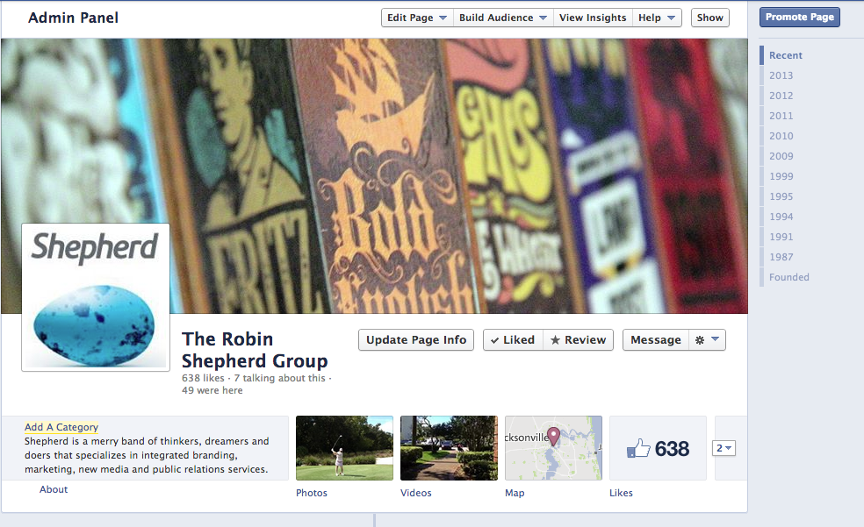
Facebook Analytics

Slide 78
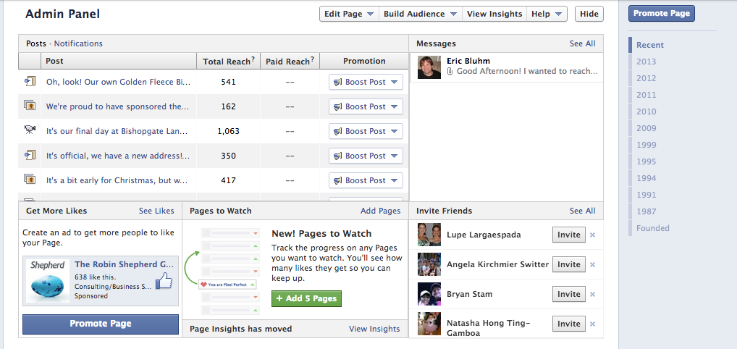
Facebook Analytics

Slide 79
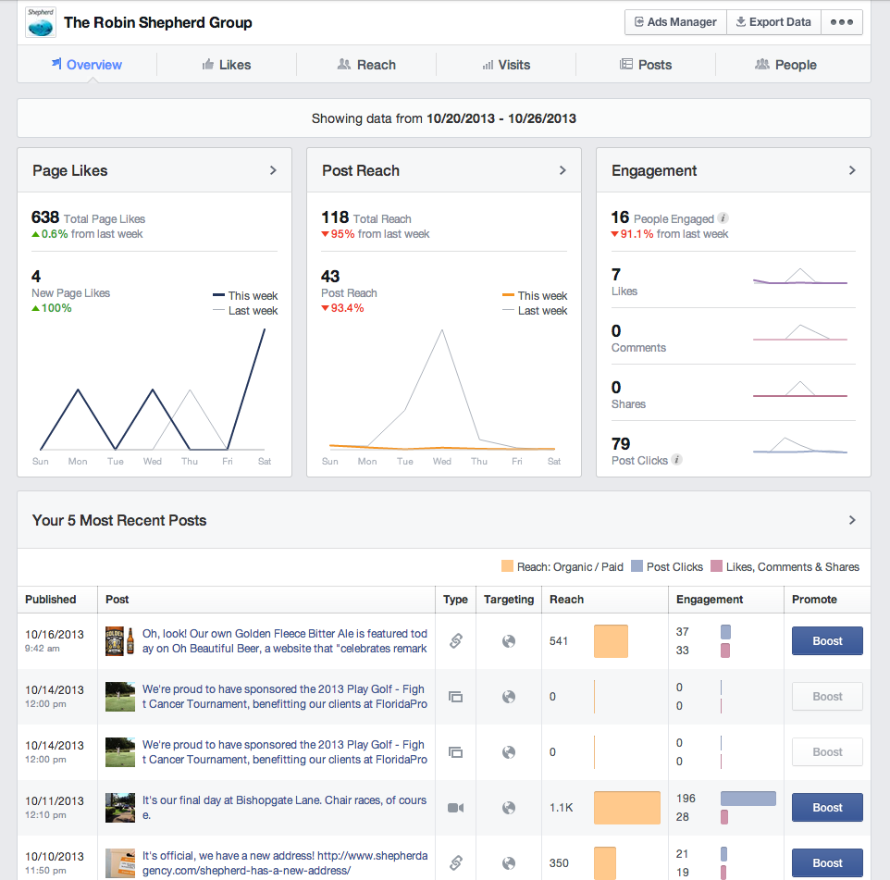
Facebook Analytics

Slide 80
Any questions about
Social Media?

Slide 81

October 29, 2013
© 2013 Shepherd. All rights reserved. Any duplication, reproduction or usage of this document or any portion thereof without the written consent from Shepherd is prohibited.

Slide 82


You have a website.
Now what?

Slide 83

Expectations
What are your Website objectives and/or expectations?
How do these expectations relate to your business objectives?
Experience
Behavior
Outcomes
Notes:
understand the customer’s experience so that you can influence the customer’s behavior
Experience, behavior and outcomes are more complex concepts that tend to encompass more than just what occurs in your website, but why it occurs and whether it has value. However, you can implement web analytics with whatever level of sophistication you desire or can afford and it will provide value or some level of understanding for your business.

Slide 84
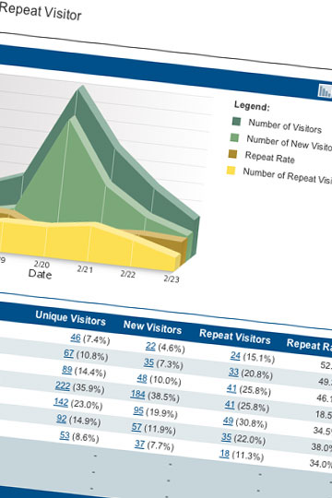




Analytics Software
Dashboards
Custom Reports
Pivots Tables
Funnel Visualization
Goal Flow
etc…
Notes:
There are dozens of analytic software solutions available today and the cost for a solution ranges from free to 6 and 7 figure prices.

Slide 85
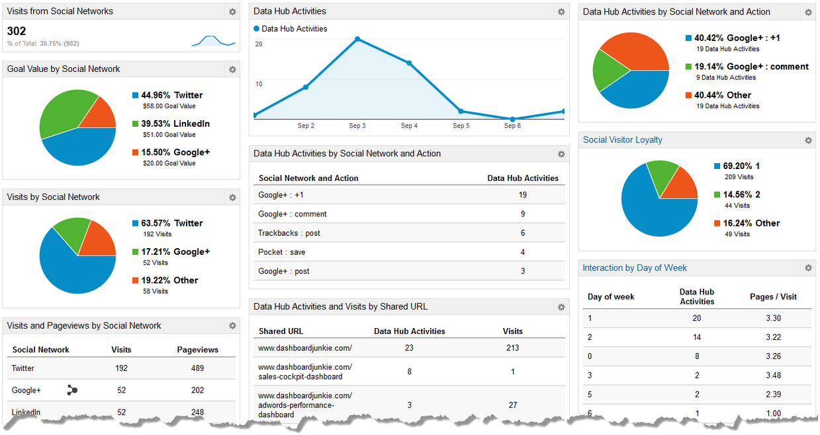
Dashboards and Custom Reports

Slide 86
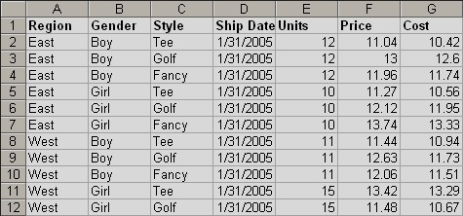
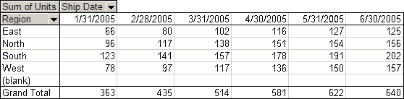
Pivot Tables

Slide 87
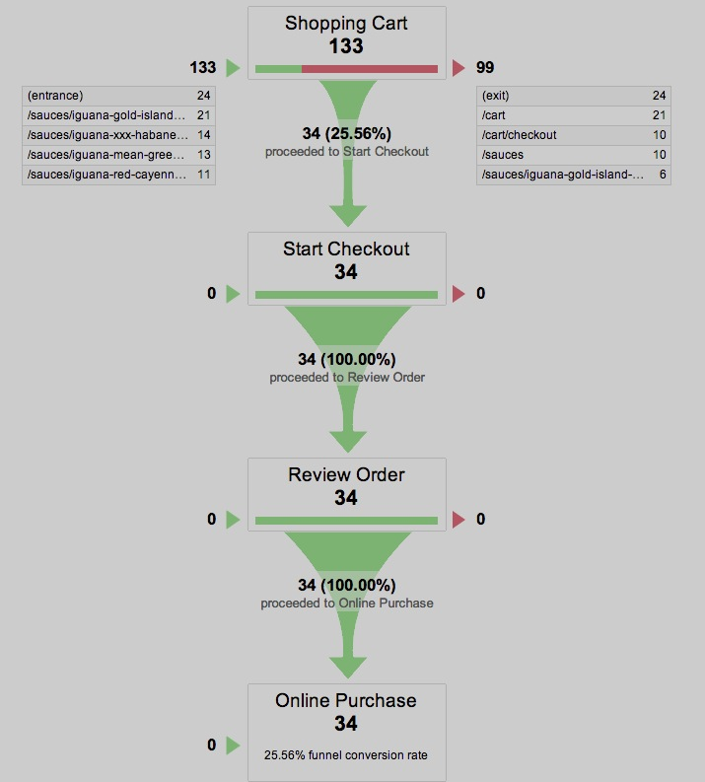
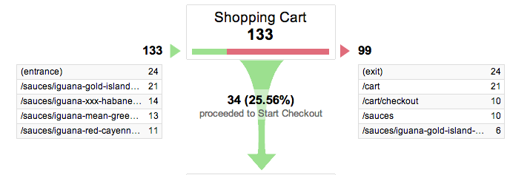
Funnel Visualization

Slide 88
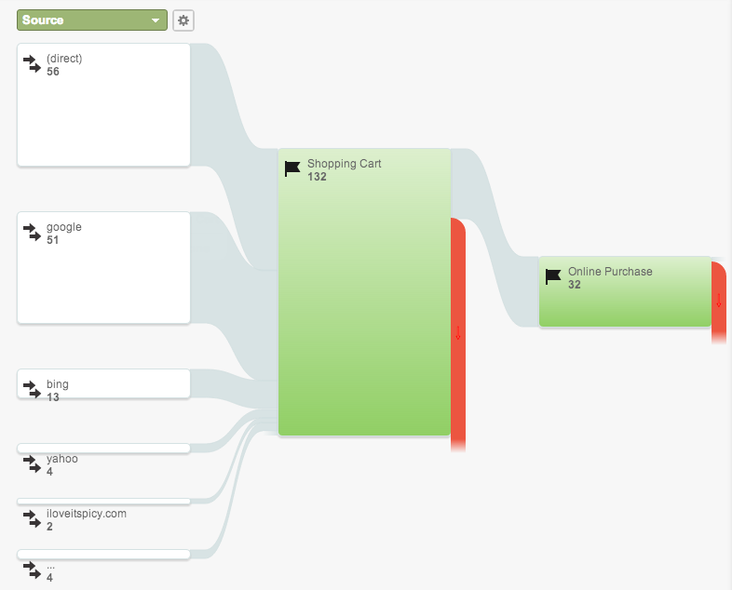
Goal Flow

Slide 89
Basic Metrics
Visits and Visitors
Time on Page/Site
Bounce Rate
Exit Rate
Conversion Rate
Engagement
(frequency; depth of Visit)
QUICK READ
RELEVANT
USEFUL
ACTIONABLE

Slide 90
Strategy and Success
ACQUISITION
ENGAGEMENT
OUTCOMES
Key Performance Indicator (KPI)
A metric to help understand how your website is performing against your objectives.
  Conversion Rate
  Cost Per Conversion
  Cost Per Acquisition (CPA)
  Bounce Rate
  Visits Per Day
  Revenue Per Visit

Slide 91
Segmentation
Paid
Search
Organic
Search
Email
Marketing

Slide 92
Any questions about
Website Analytics?

Slide 93
Toolkit Website
www.historiccoastculture.com/toolkit
Upcoming workshops:
        Pre-launch marketing review/Q&A
        Post-launch review/Q&A
        Campaign effectiveness review/Q&A

Slide 94
© 2013 Shepherd. All rights reserved. Any duplication, reproduction or usage of this document or any portion thereof without the written consent
from Shepherd is prohibited.

